Slide 1

SPITRACK
Simplifying Research Techniques

Slide 2

Team Members - Eccentrics
Mohammad Nabiluzzaman Neloy 1831251042 mohammad.nabiluzzaman@northsouth.edu
Rafid Ahmed 1831395642 rafid.ahmed@northsouth.edu

Slide 3
Organization

Slide 4
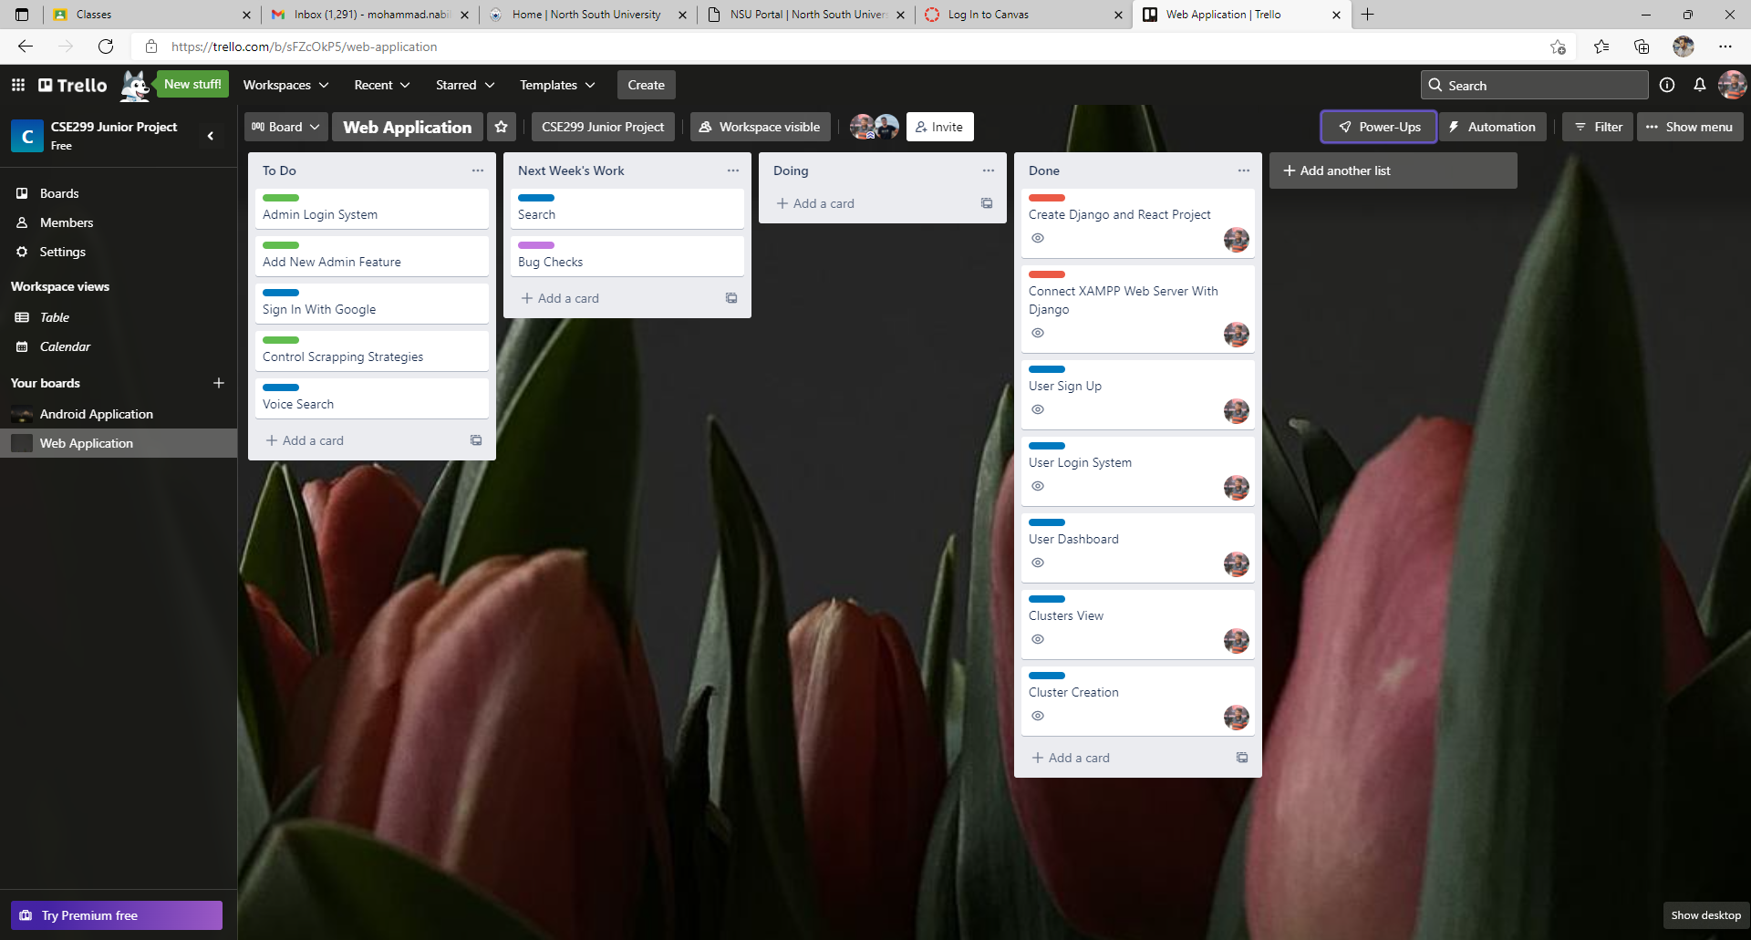
Web Application (Neloy): Trello Board

Slide 5
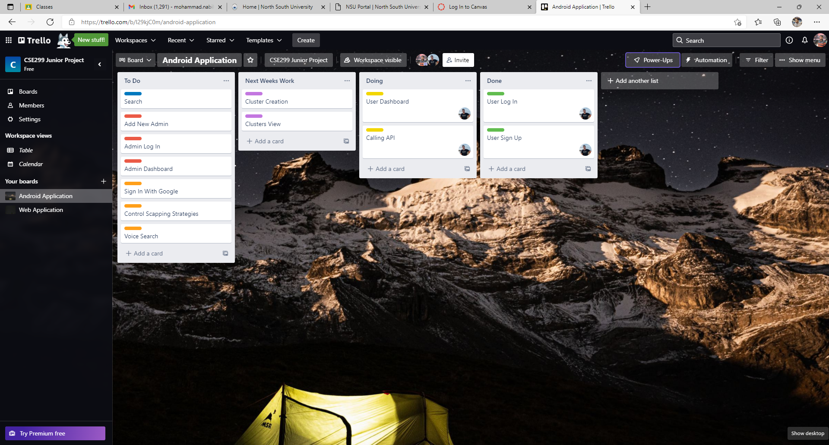
Android Application (Rafid): Trello Board

Slide 6
Communication

Slide 7
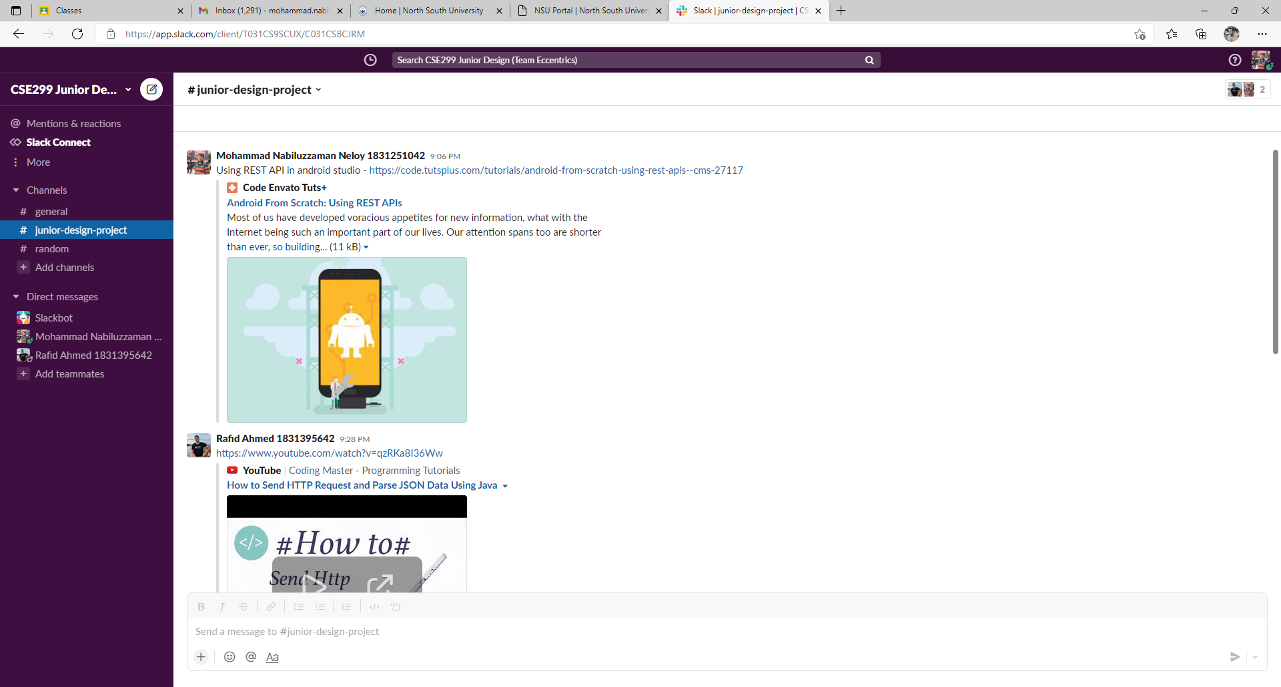
Mostly in Messenger, but project related updates are done in Slack

Slide 8
Work – WebApp (Neloy)

Slide 9
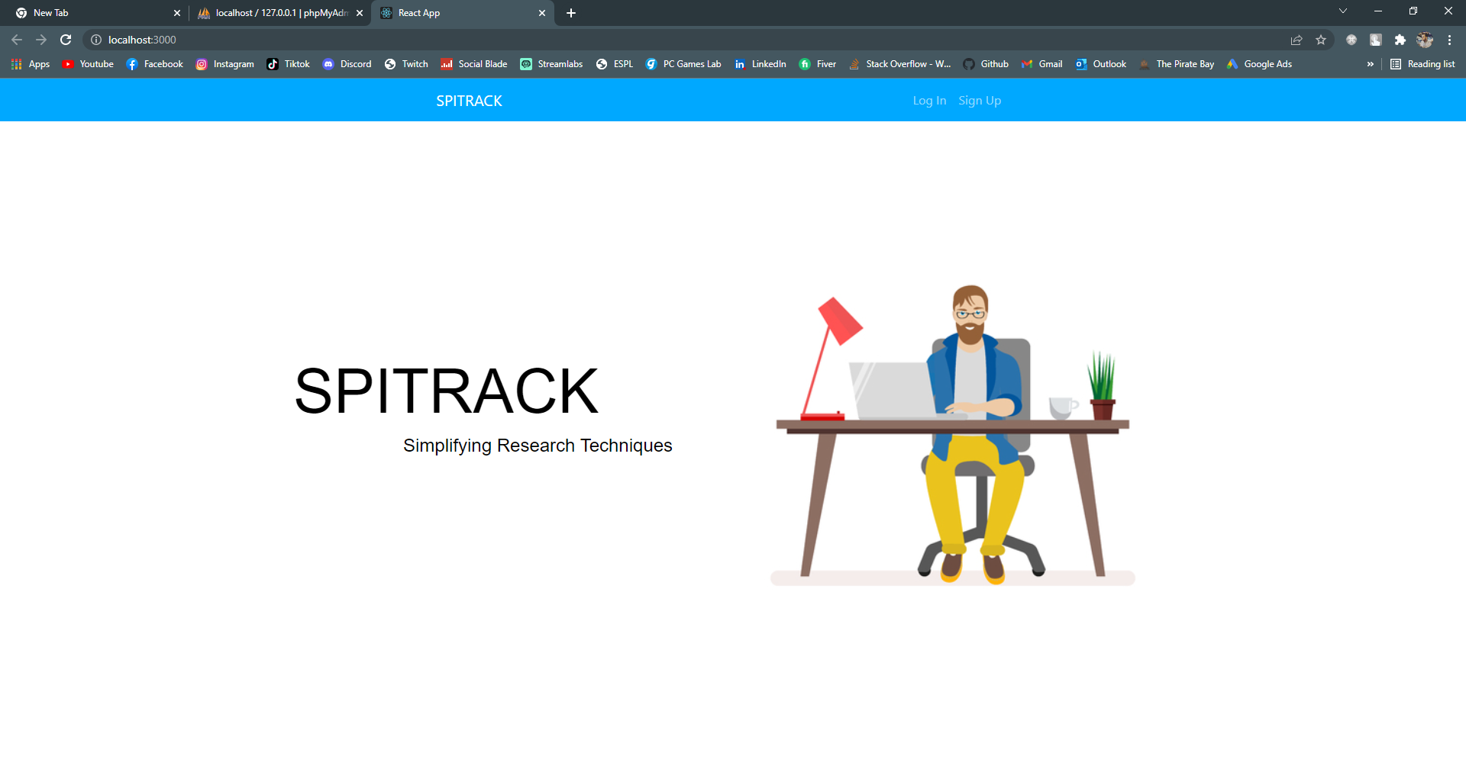
Web Application (Neloy): Landing Page

Slide 10
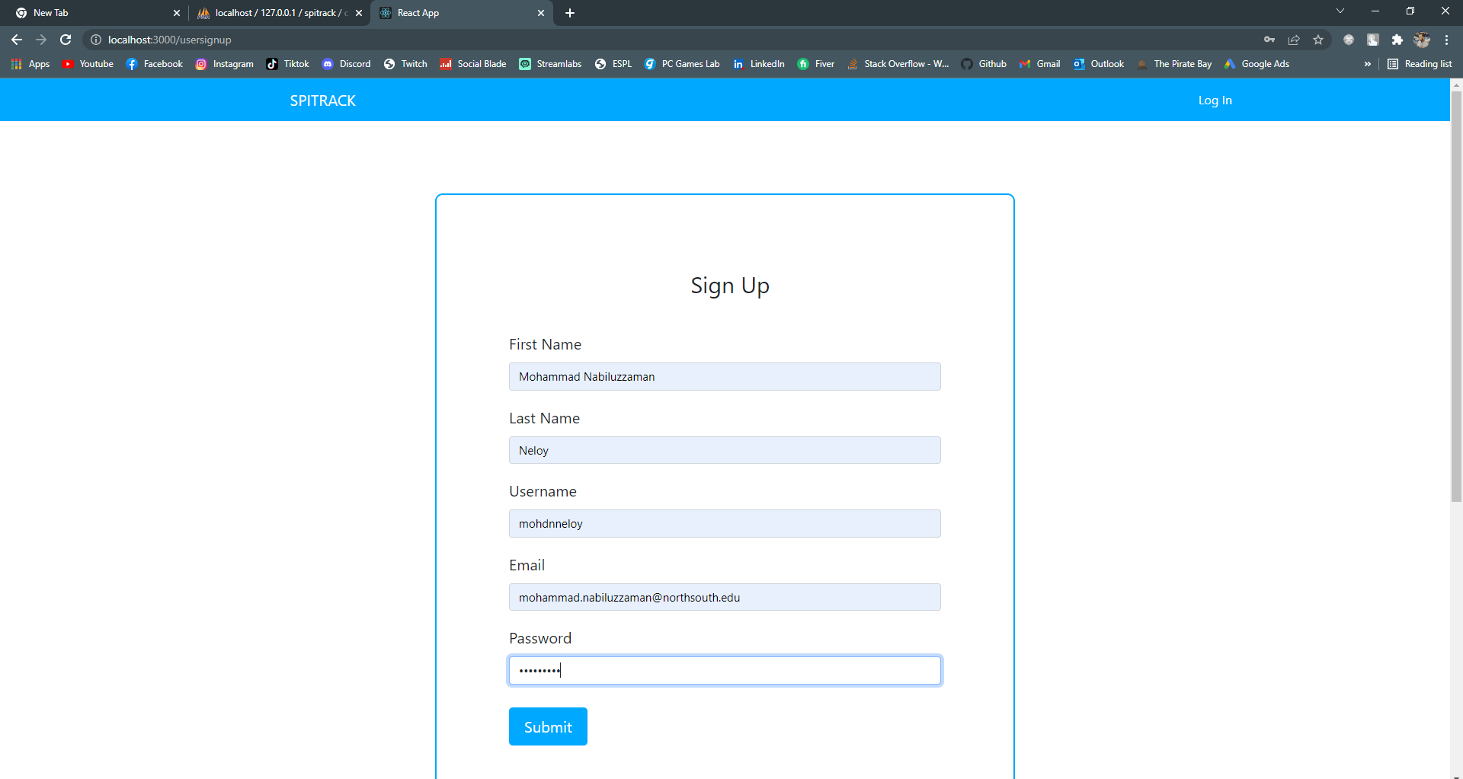
Web Application (Neloy): Sign Up

Slide 11
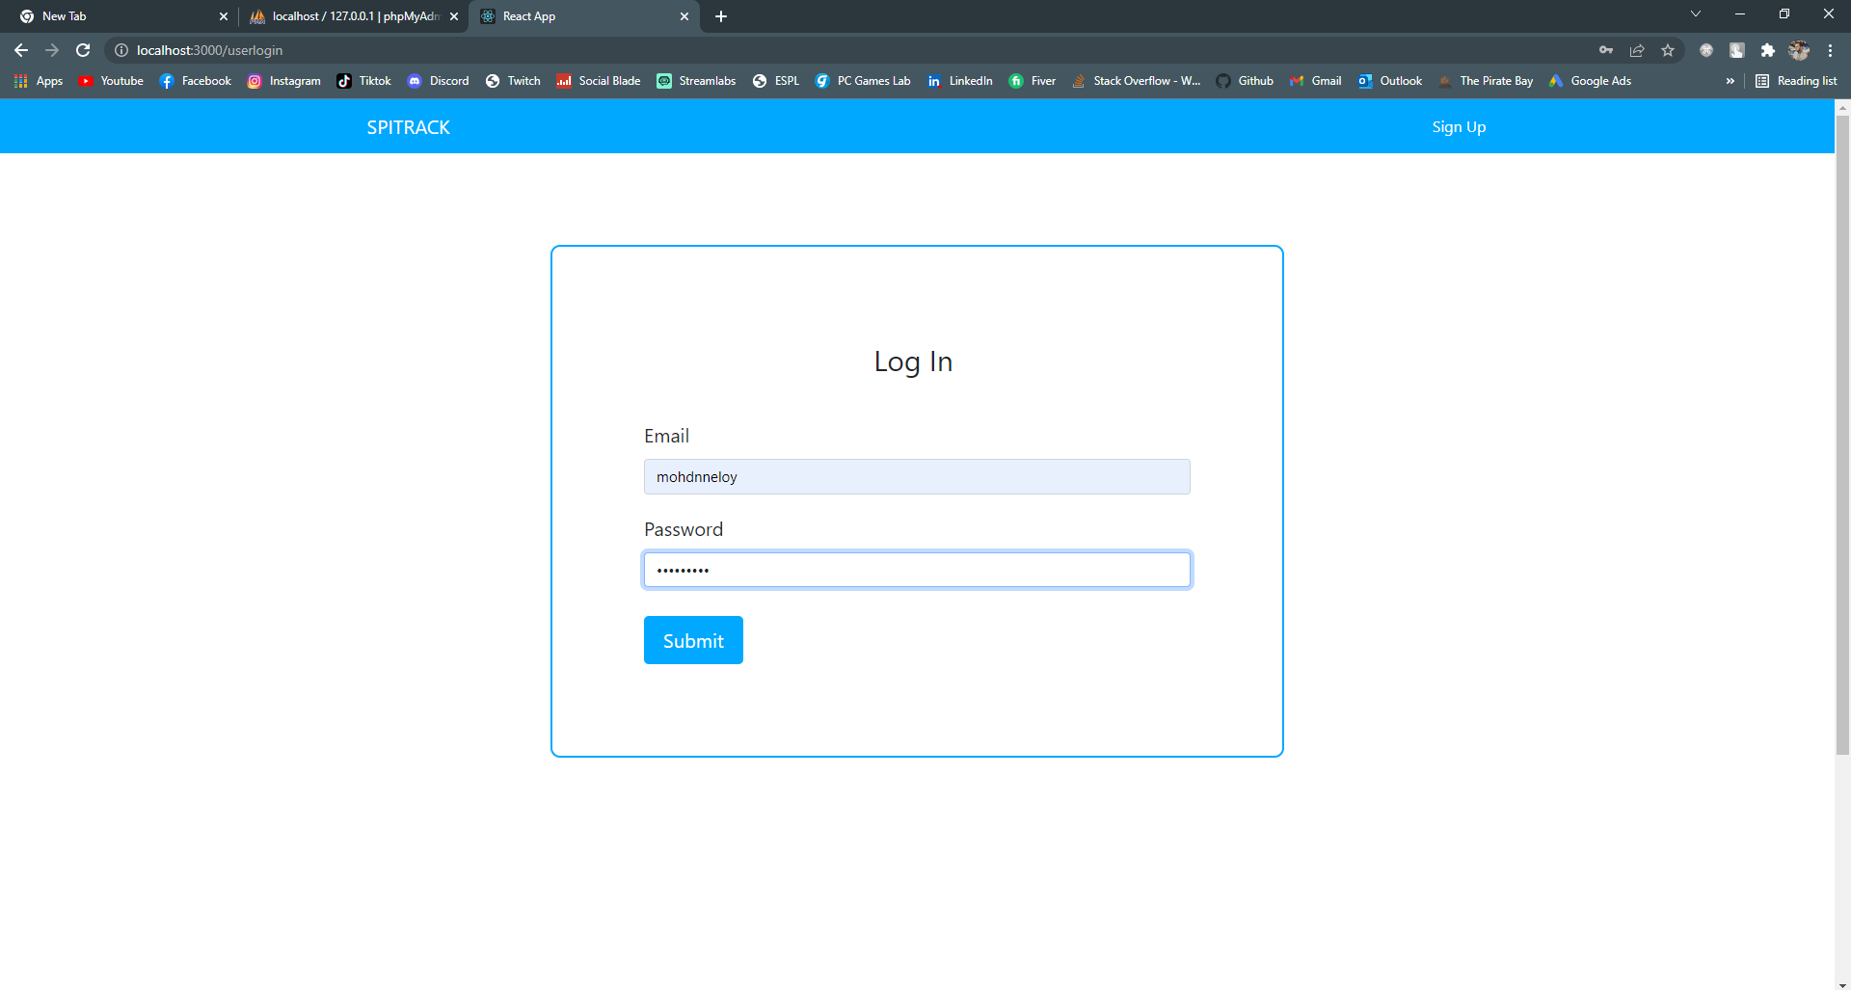
Web Application (Neloy): Log In

Slide 12
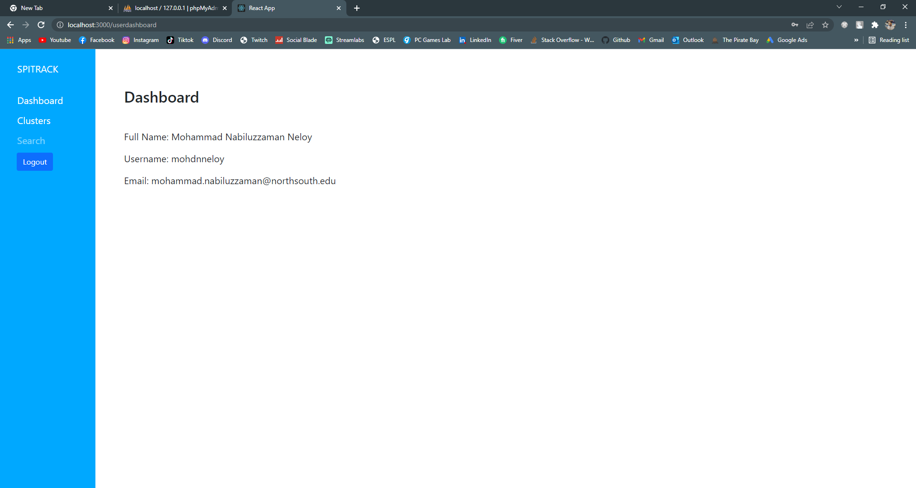
Web Application (Neloy): User Dashboard

Slide 13
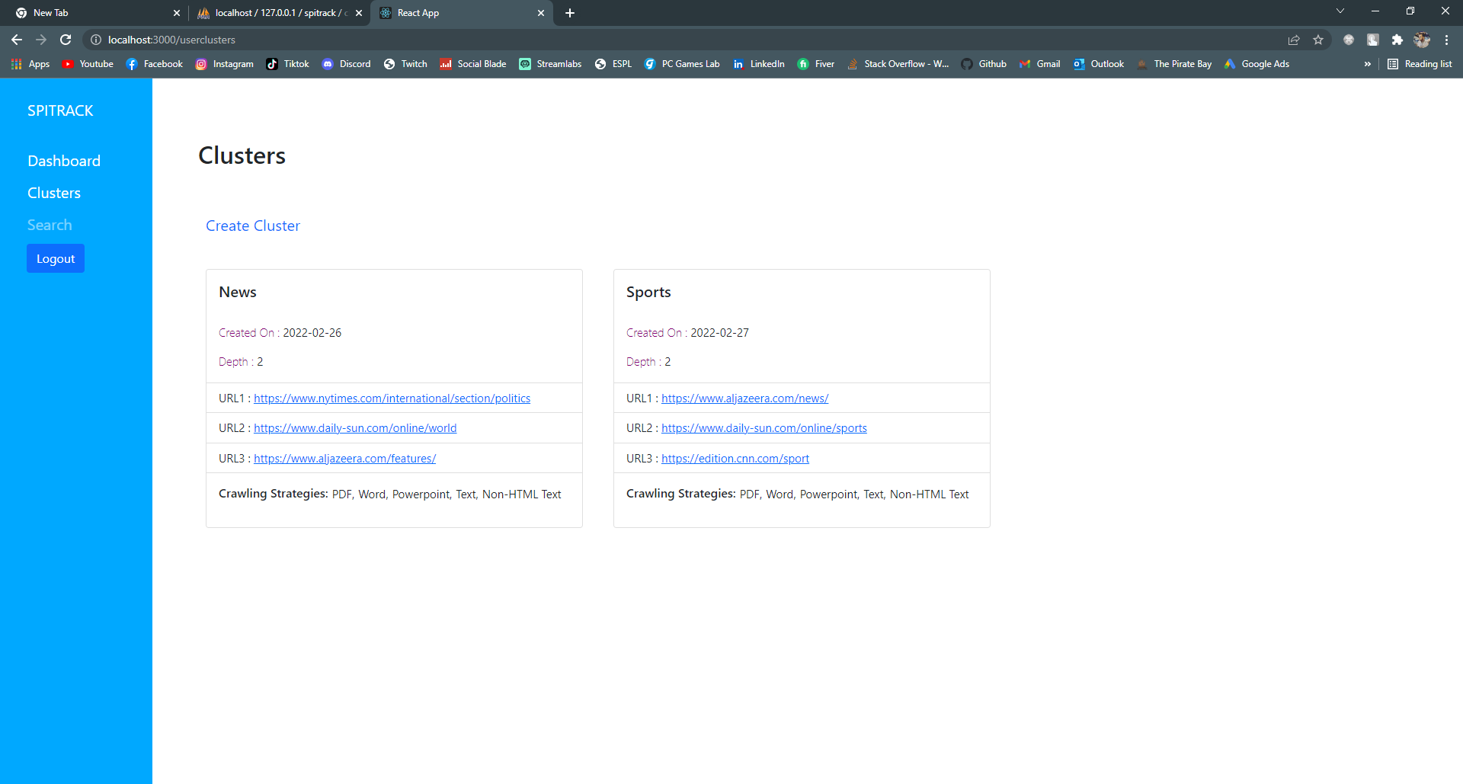
Web Application (Neloy): Clusters 1

Slide 14
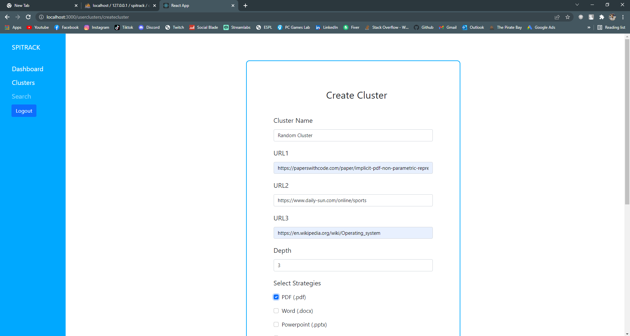
Web Application (Neloy): Create Cluster 1

Slide 15
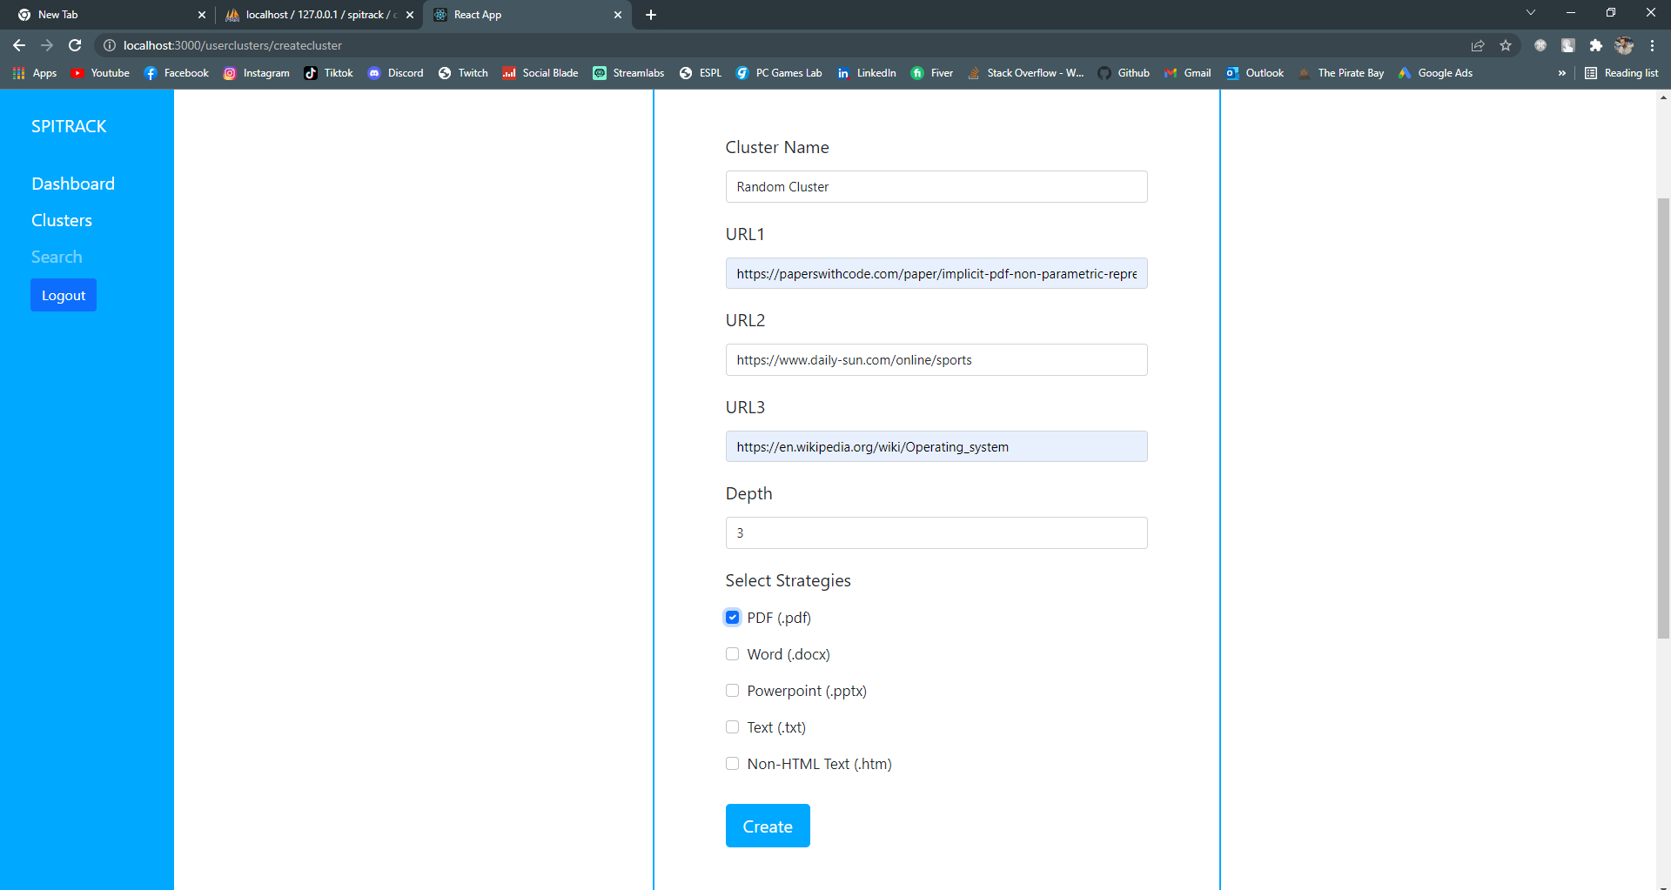
Web Application (Neloy): Create Cluster 2

Slide 16
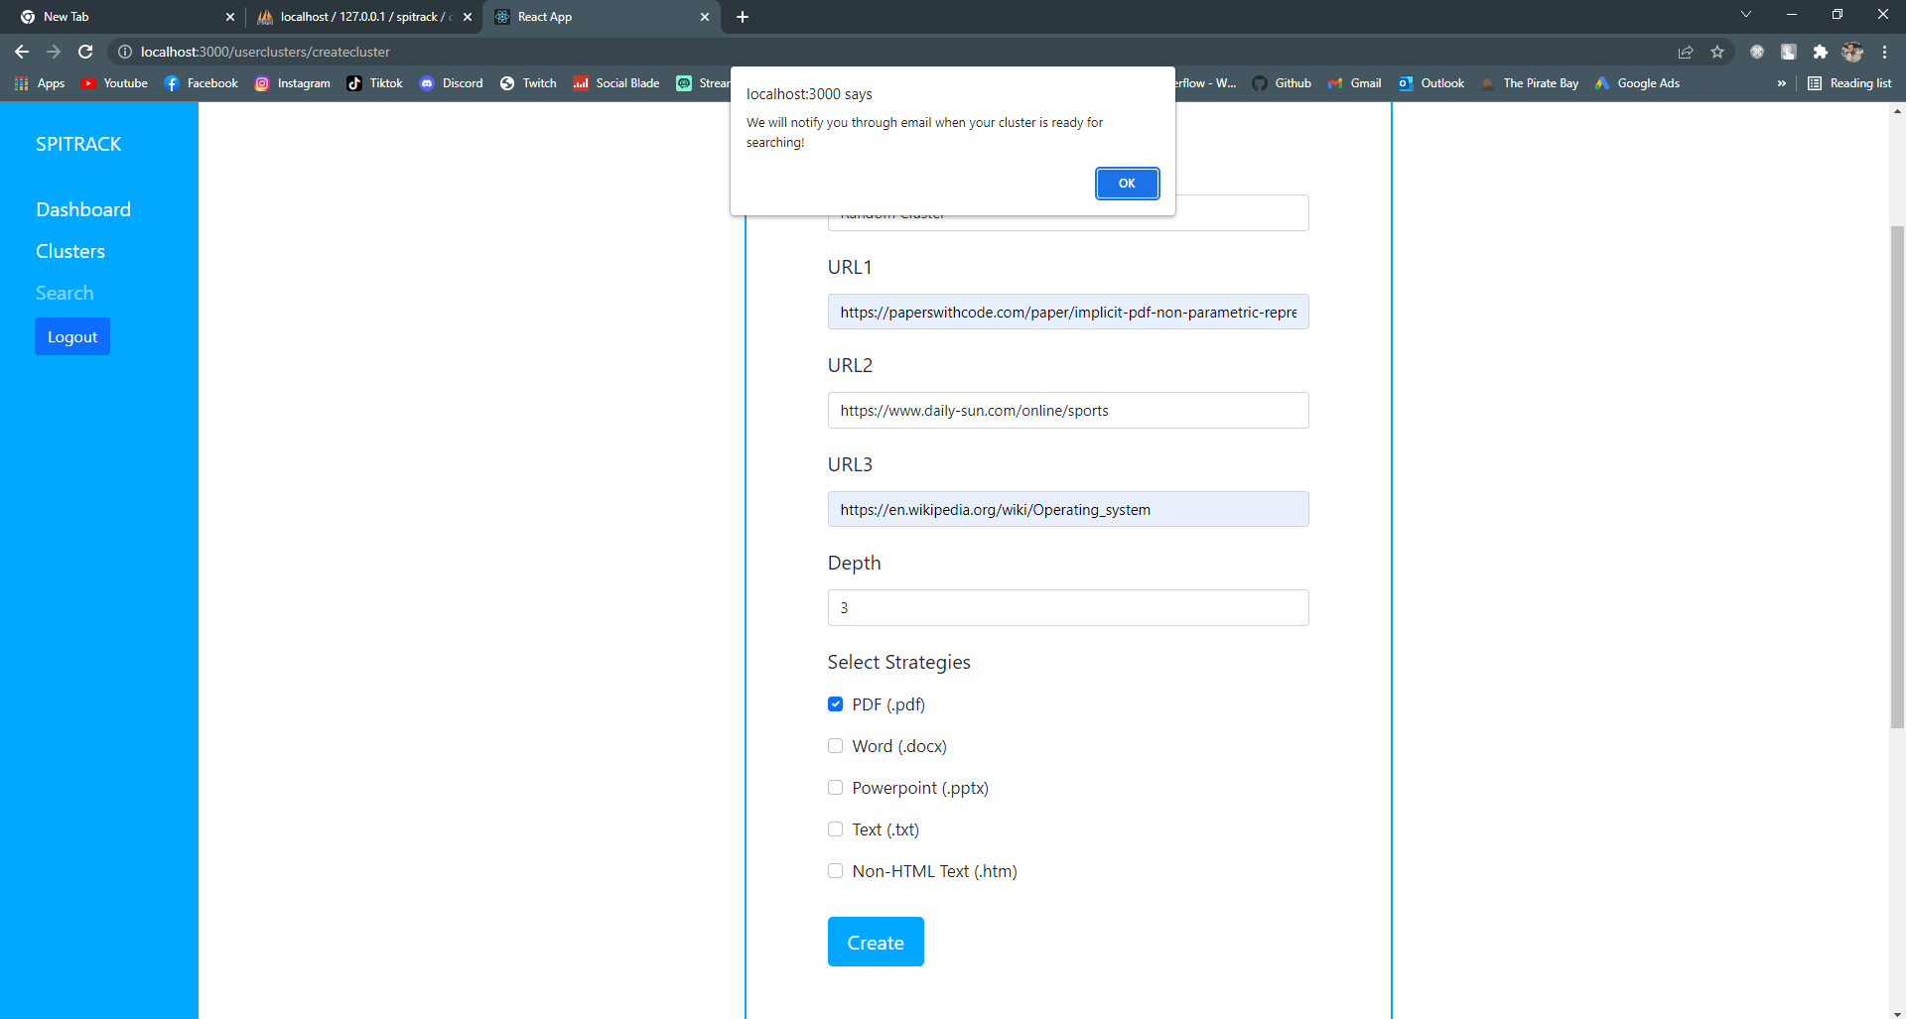
Web Application (Neloy): Create Cluster 3

Slide 17
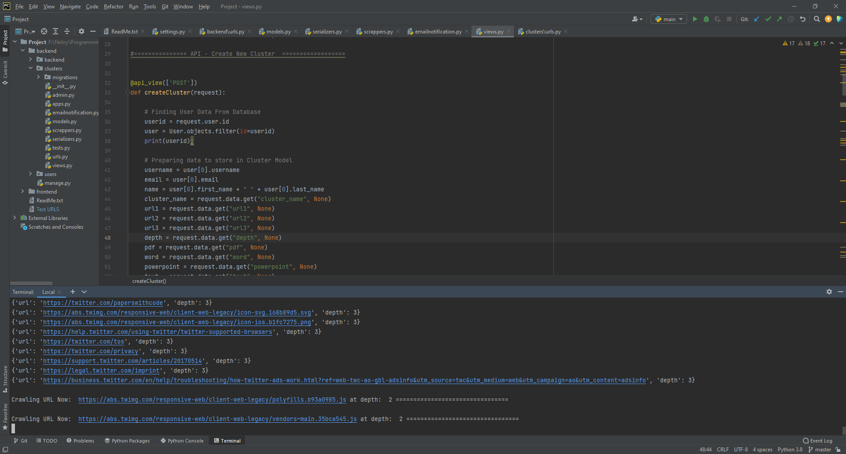
Web Application (Neloy): Create Cluster API (Scrapping)

Slide 18
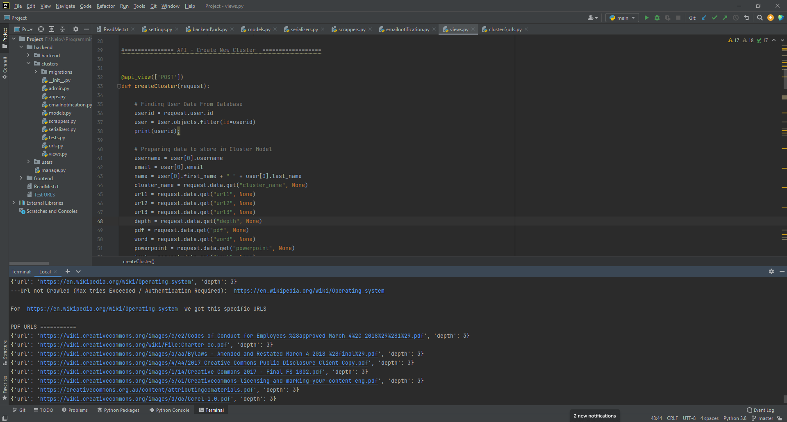
Web Application (Neloy): Create Cluster API (URL type separation)

Slide 19
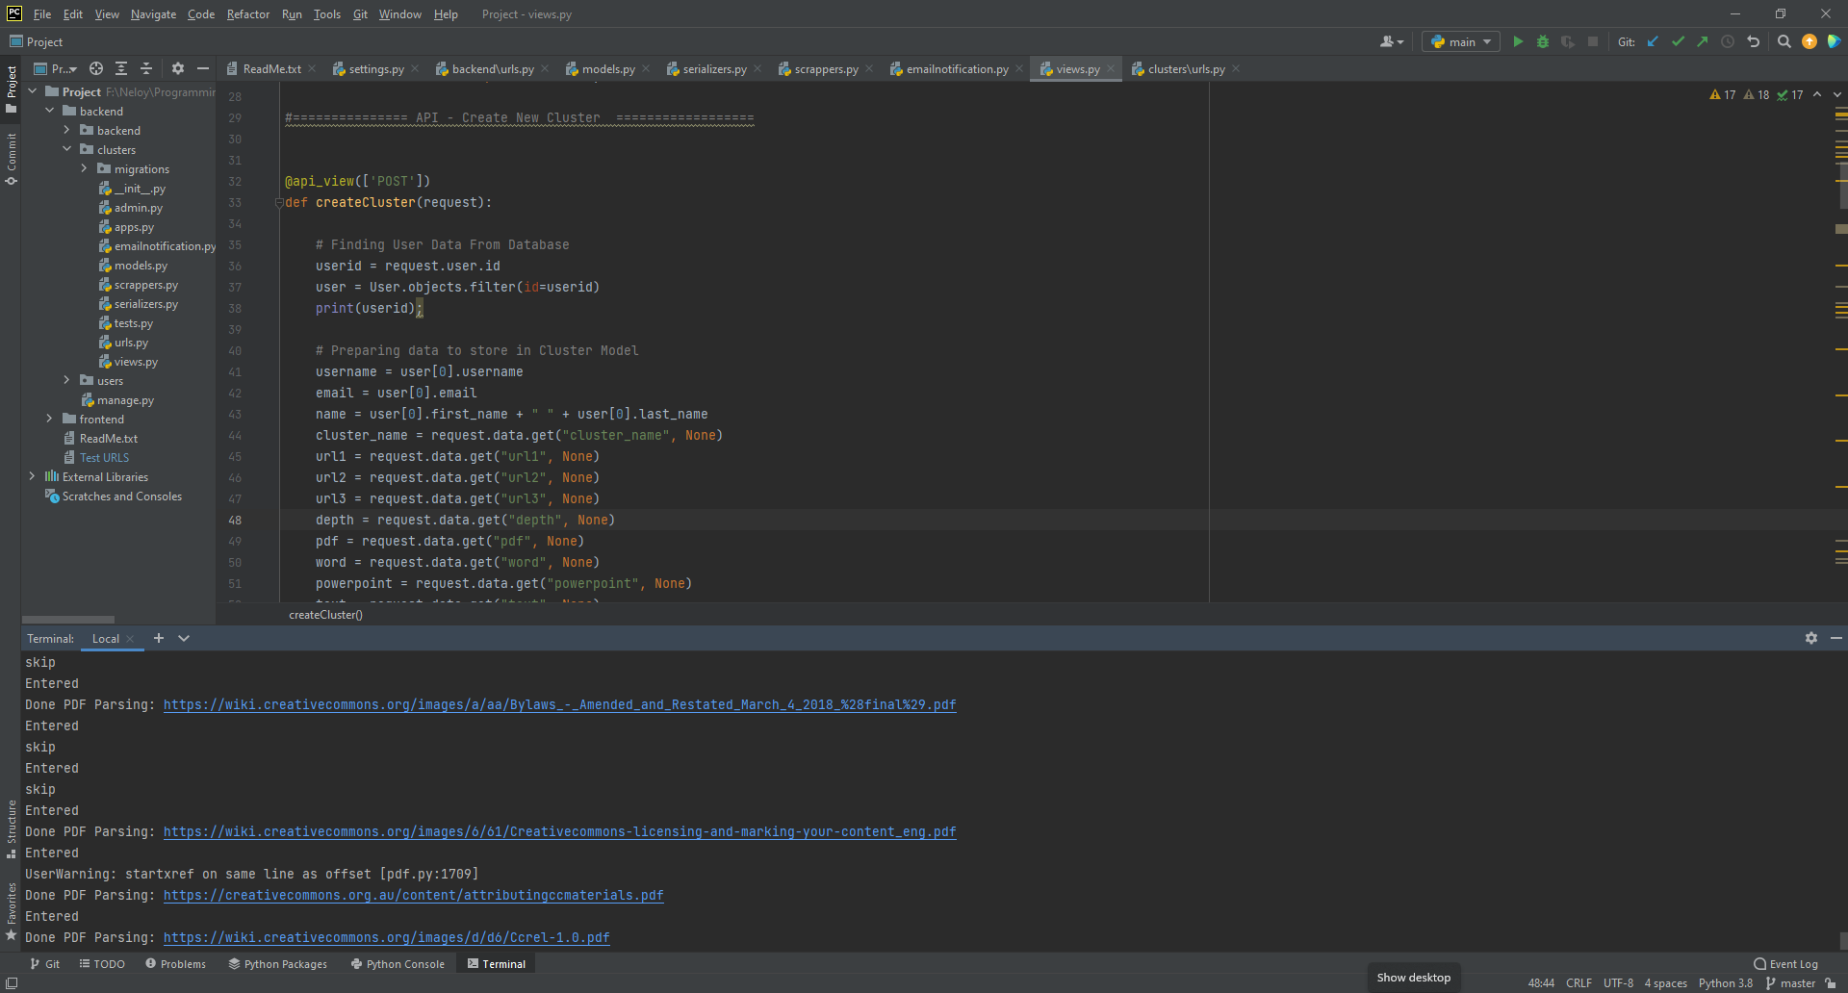
Web Application (Neloy): Create Cluster API (Parsing)

Slide 20
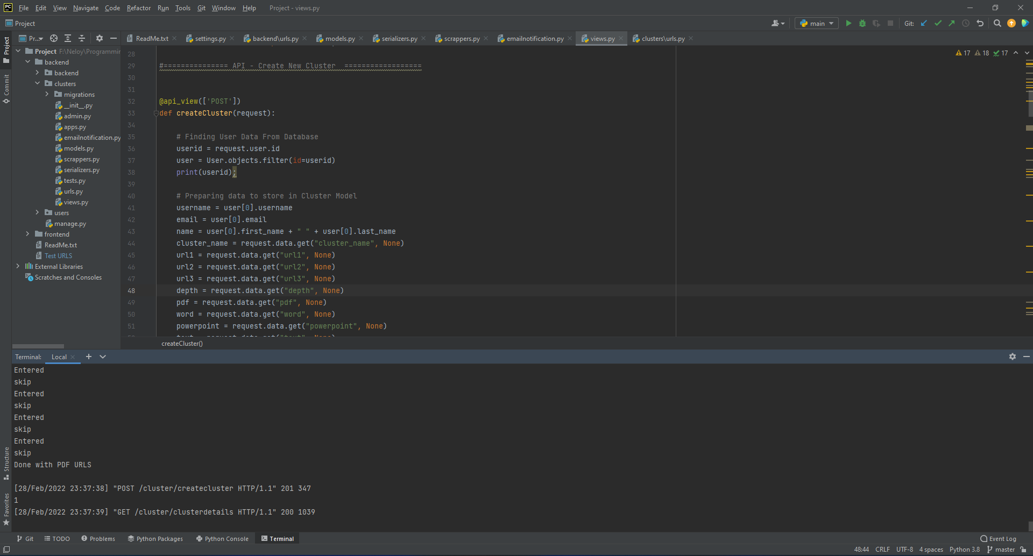
Web Application (Neloy): Create Cluster API (Task Completion in Backend)

Slide 21
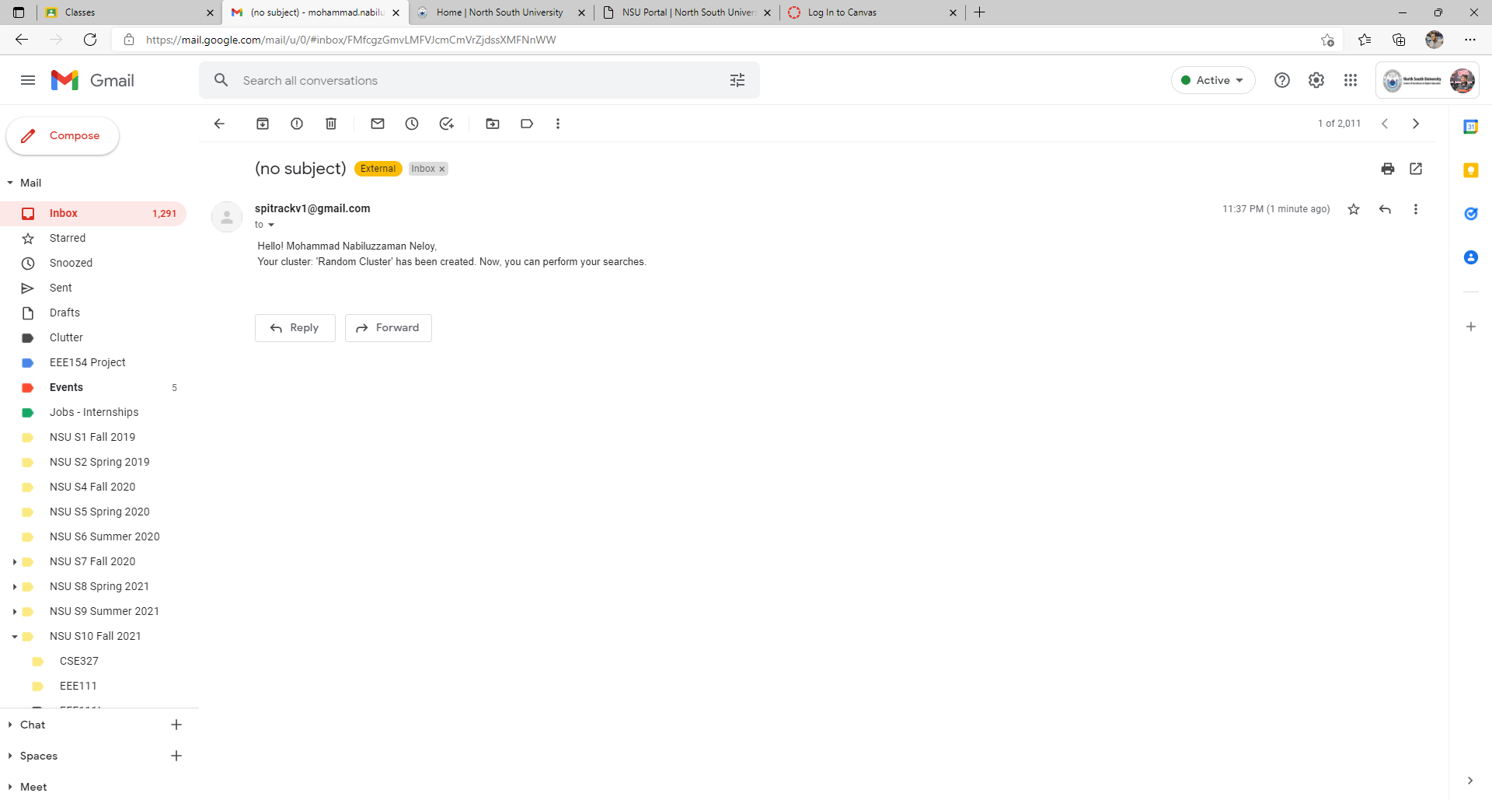
Web Application (Neloy): Create Cluster (Email Notification)

Slide 22
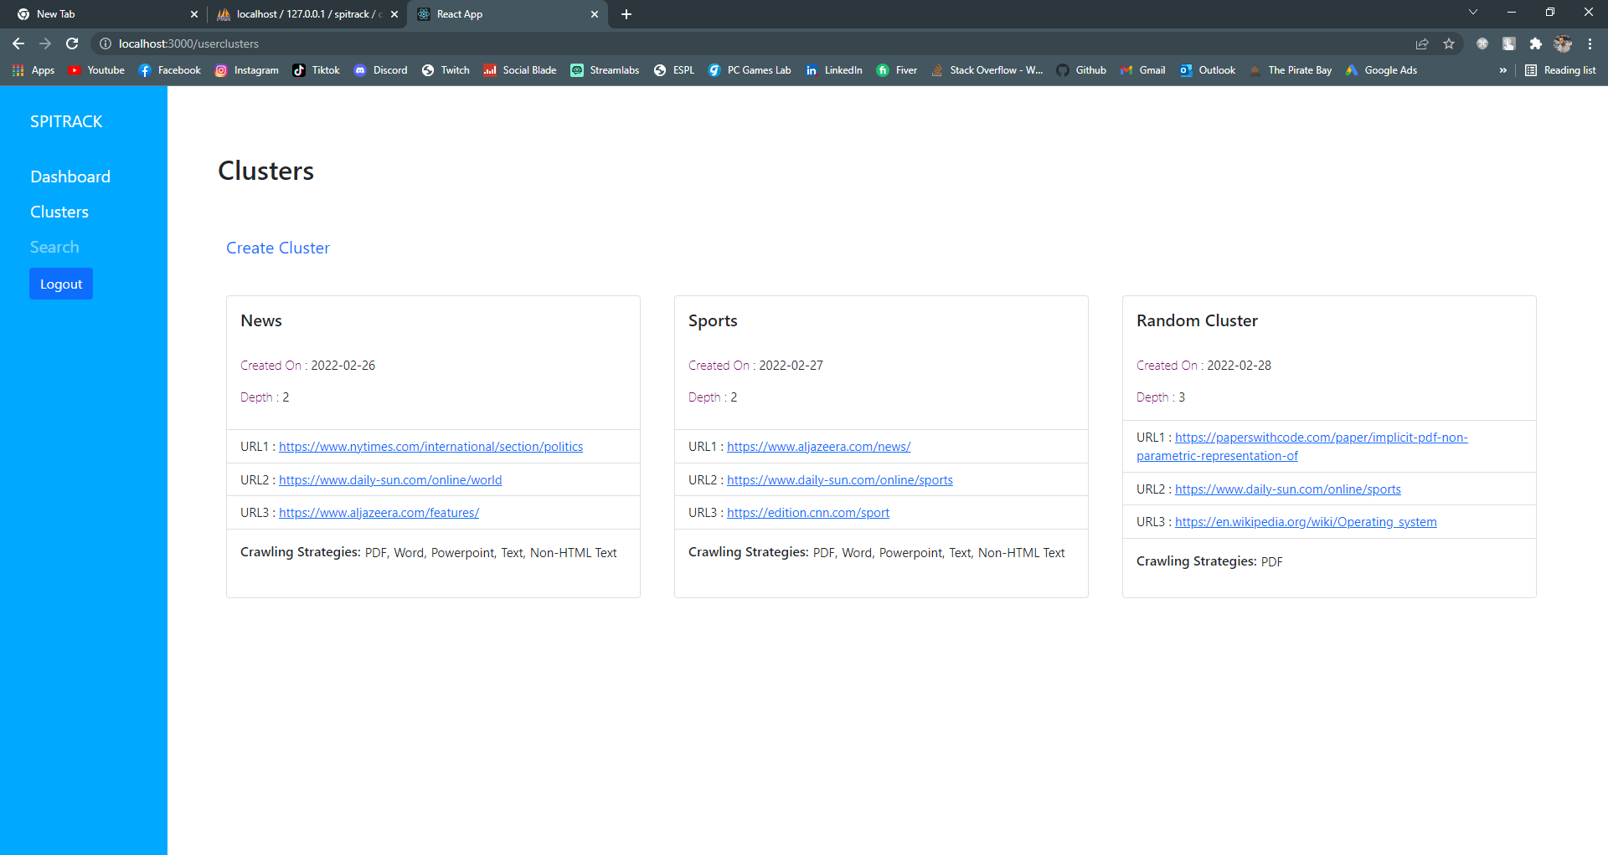
Web Application (Neloy): Clusters 2

Slide 23
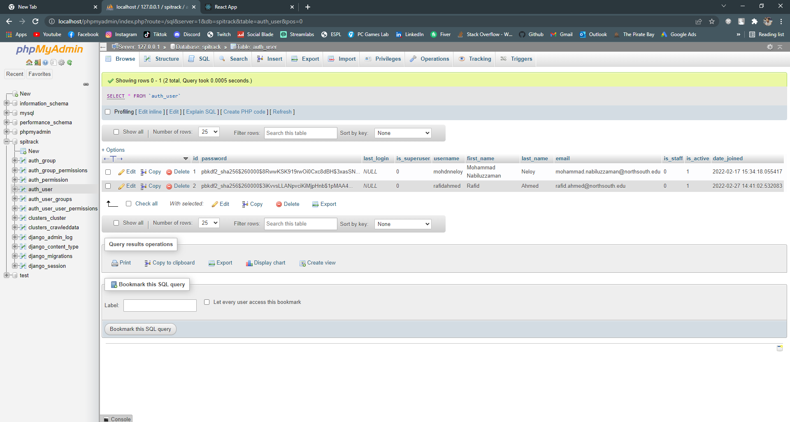
Web Application (Neloy): Database (Users Table)

Slide 24
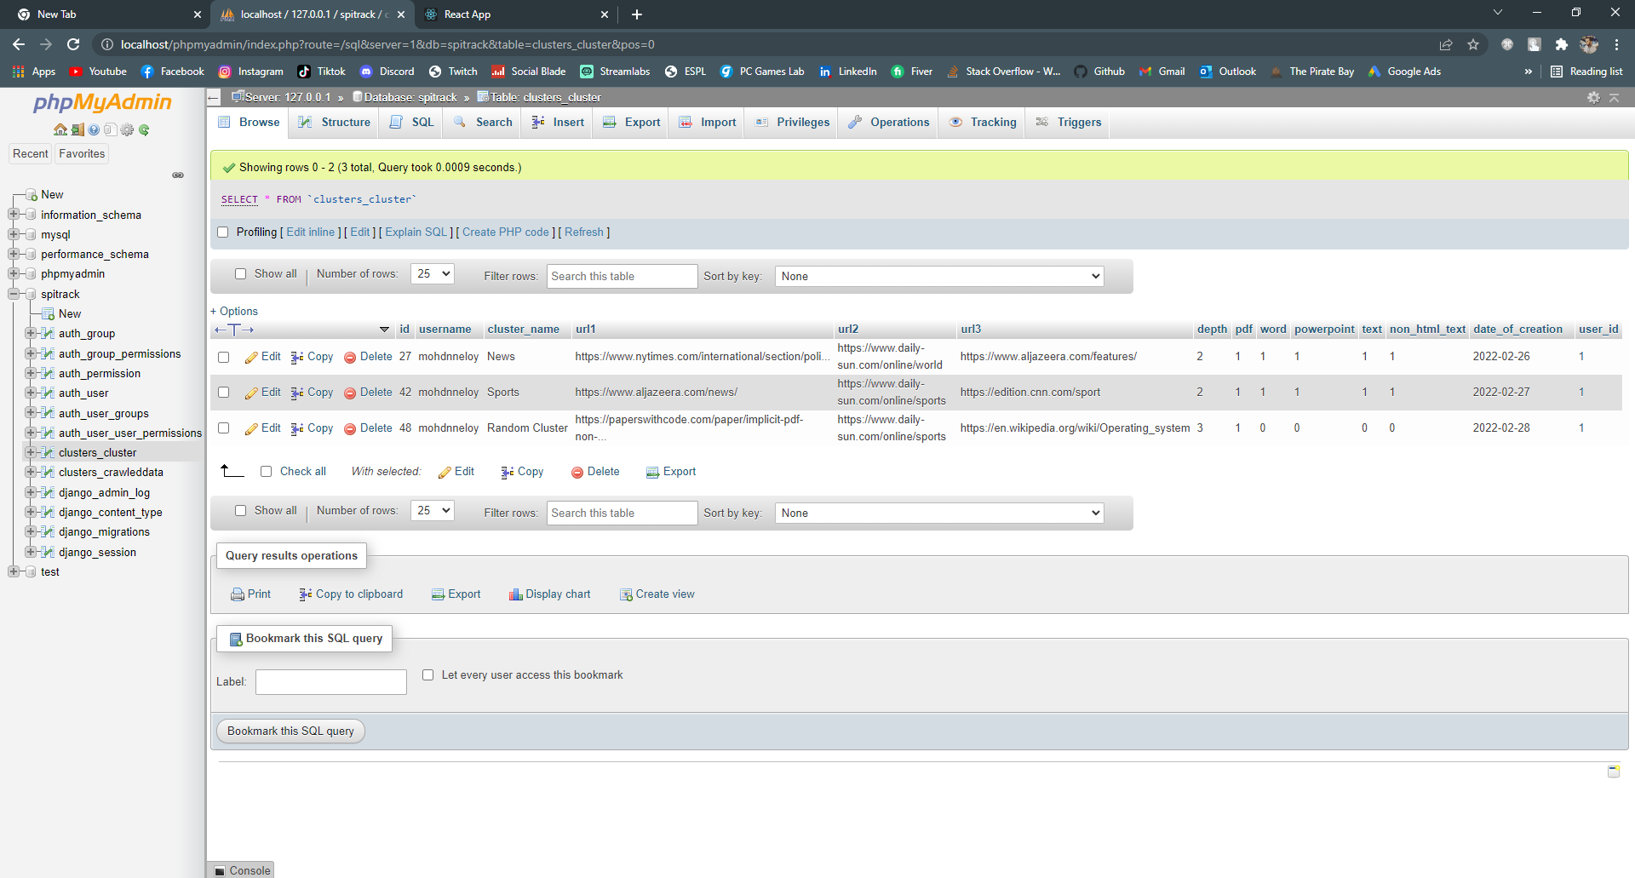
Web Application (Neloy): Database (Clusters Table)

Slide 25
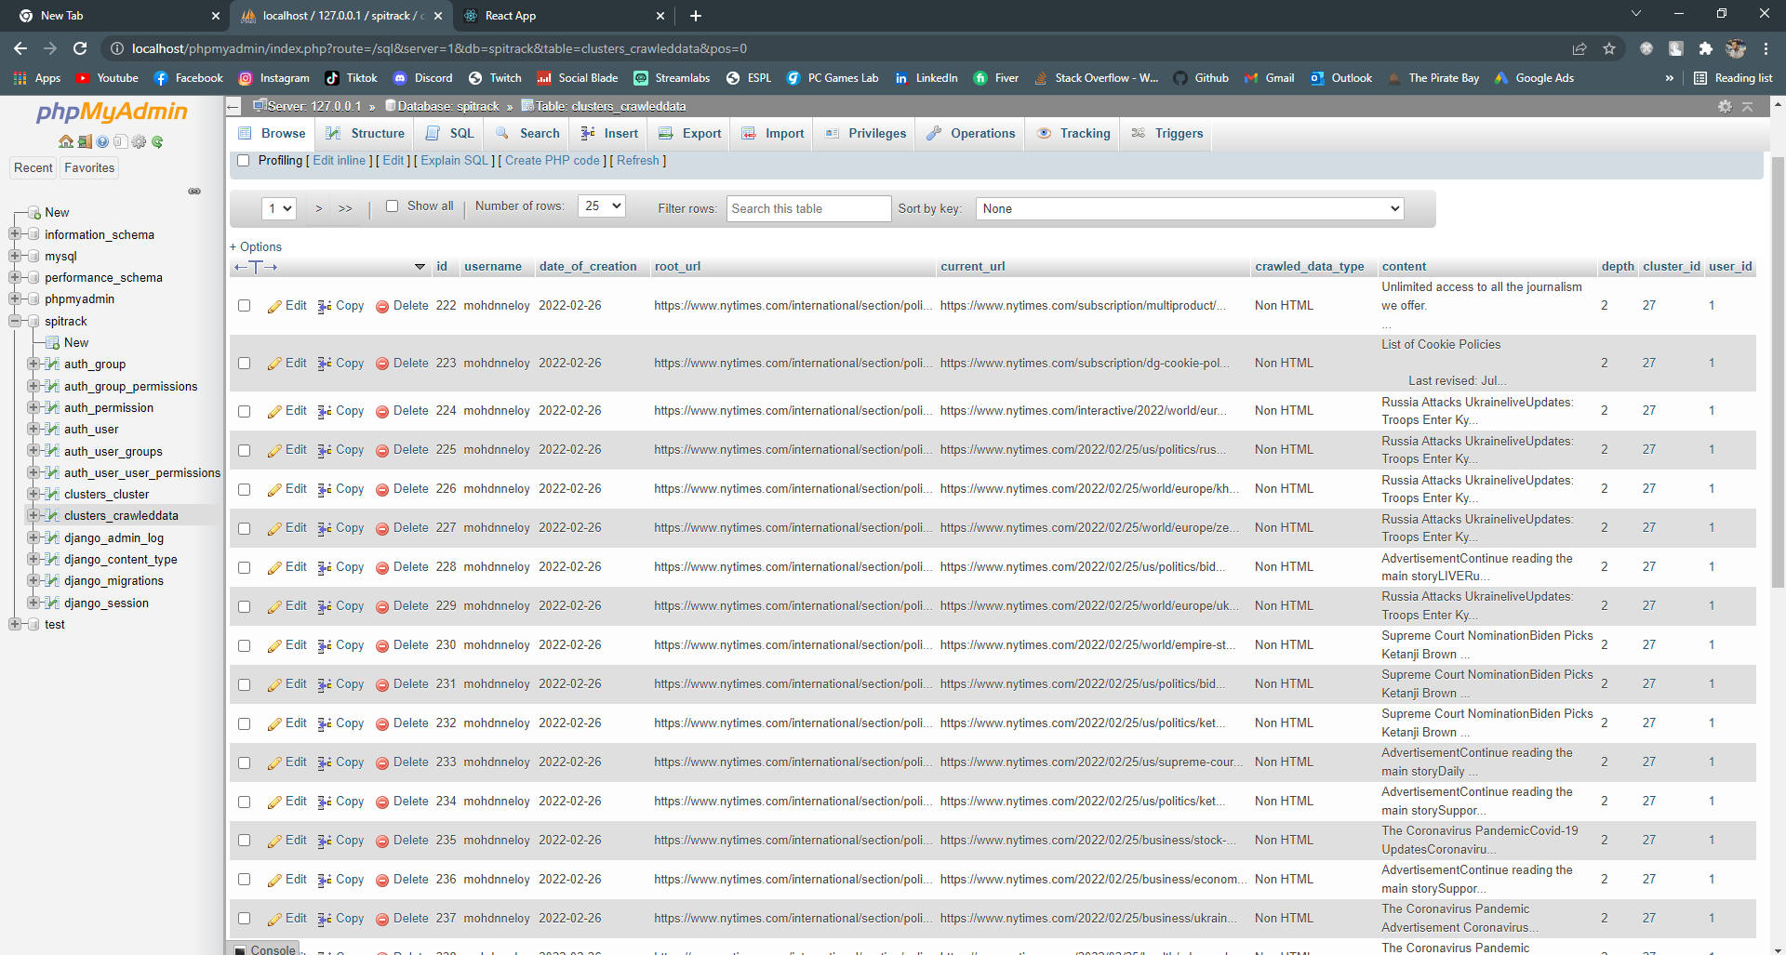
Web Application (Neloy): Database (Crawled Data 1)

Slide 26
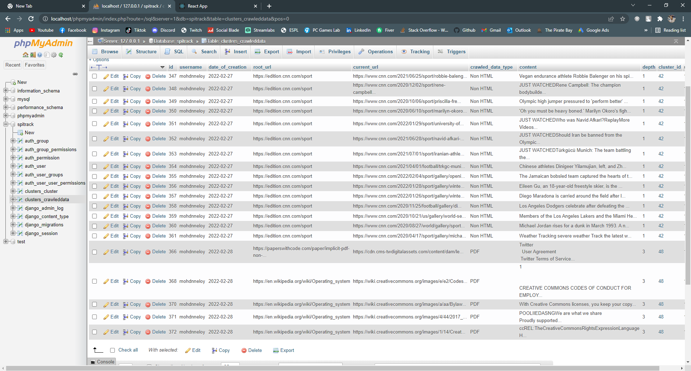
Web Application (Neloy): Database (Crawled Data 2)

Slide 27
Work – Android App (Rafid)

Slide 28
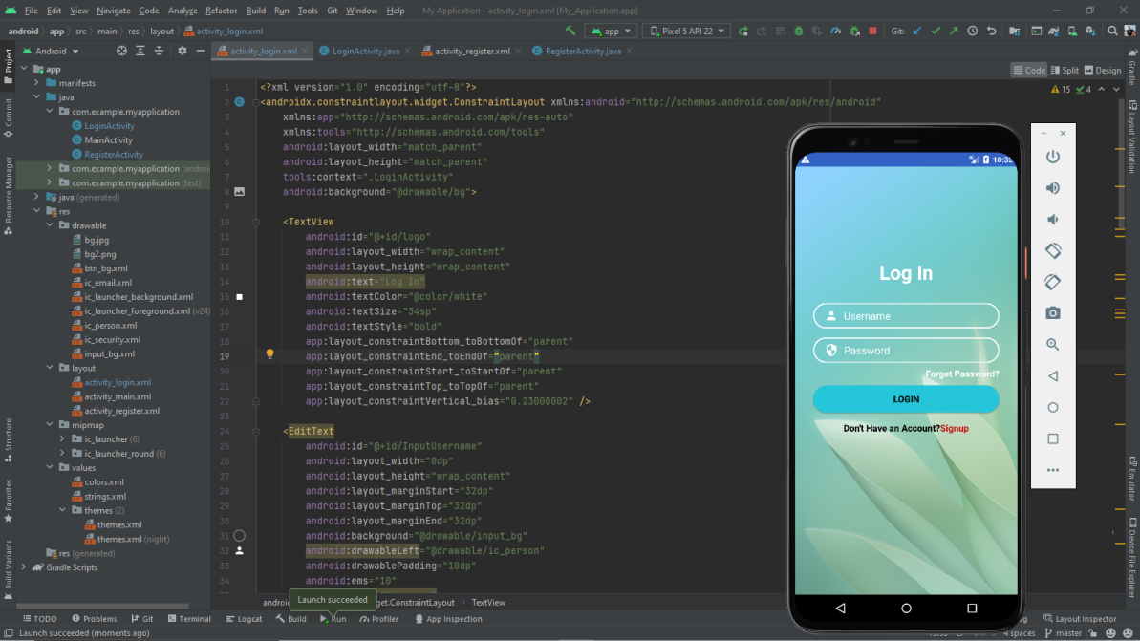
Android Application (Rafid): Log In Design (XML)

Slide 29
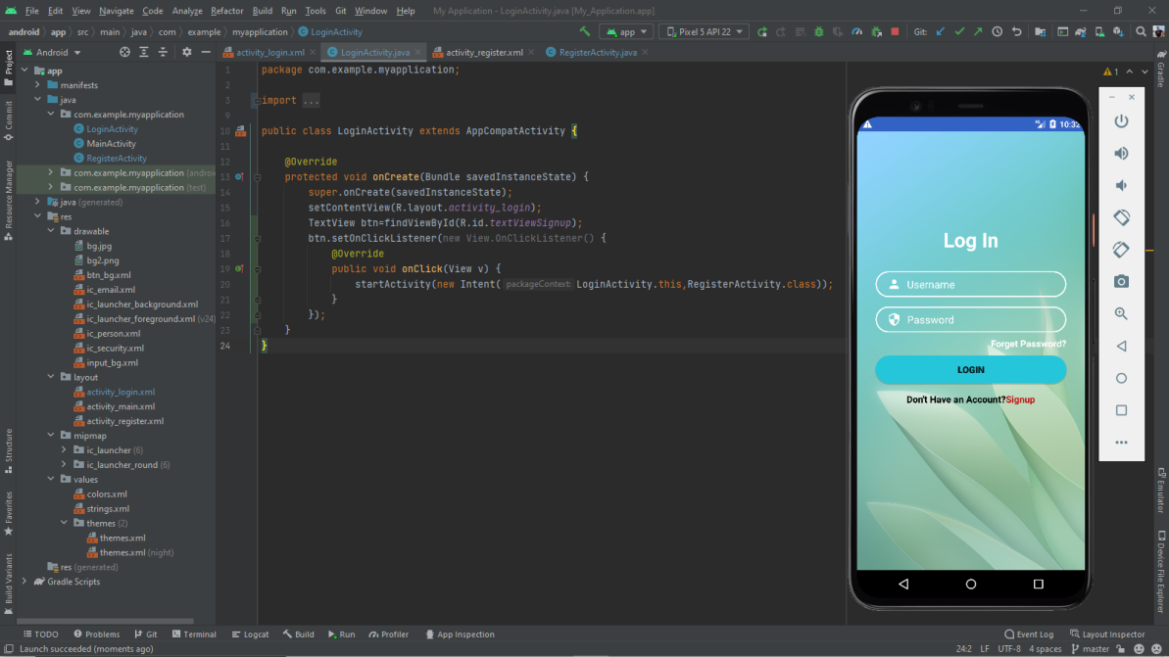
Android Application (Rafid): Log In Design (Java)

Slide 30
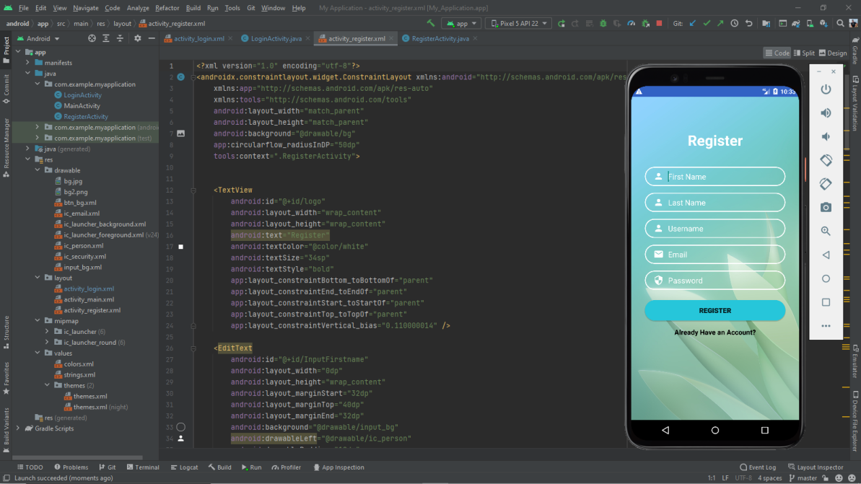
Android Application (Rafid): Register or Sign Up Design (XML)

Slide 31
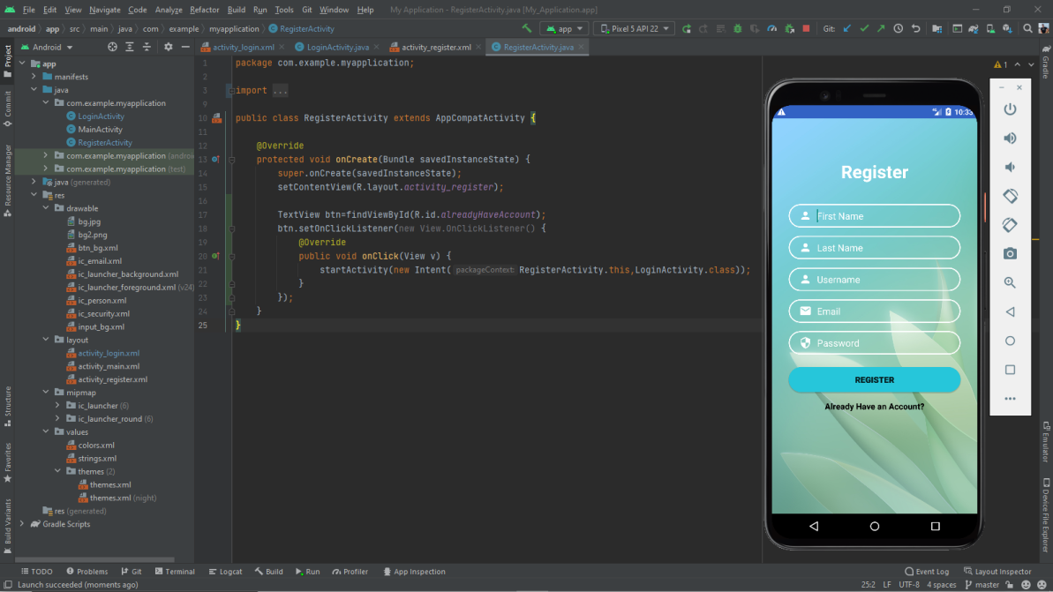
Android Application (Rafid): Register or Sign Up Design (Java)

Slide 32
Thank You!

